Slide 1
FORCE-BASED PARAMETER ANALYSIS
Summary of the meeting in last week
Uniform sampling method
Group cohesion analysis based on ISOMAP
4. Group speed analysis based on ISOMAP
5. Locally Linear Embedding analysis
6. Discussion
Notes:
The effect of group behaviour on crowd dynamics.-> to extract useful information (interaction between group) for evacuation plan (should escape group or alone, group by group) according to parameters of each group;
In various design layout- , flow rate average, flow rate of each group.
Discussion about which design layouts suitable, plans suit for group having maximum group cohesion, or group speed., guidance for evacuation plan
-----------------------------------------------------------------------------------------------------------------------------------------------------------------------------------------------------------------
What is data in panic situations useful for human crowd modelling? Hard because data in panic is rare, not fix. Previous studies almost investigate general data for context detection at dense place; or data in normal situation; or machine learning for abnormal behaviour detection model when disaster already happened- not for panic situations. While panic situations- group of pedestrians escape together rather escape alone), with learder or group of different ped parameter distribution. This study focuses on the instinct characteristic of group behaviour in simulations when they interact in order to extract useful information before disasters happen.
Discussion about which design layouts suitable, plans suit for maximizing group cohesion, or group speed. – Group contains pedestrians having different parameter to those of others.
The data of extracting interaction between groups in which groups have different parameters to those of others (group have maximize group cohesion, group have low speed) .
Guidance for each group evacuation; adding stochastic information dynamic context

Slide 2
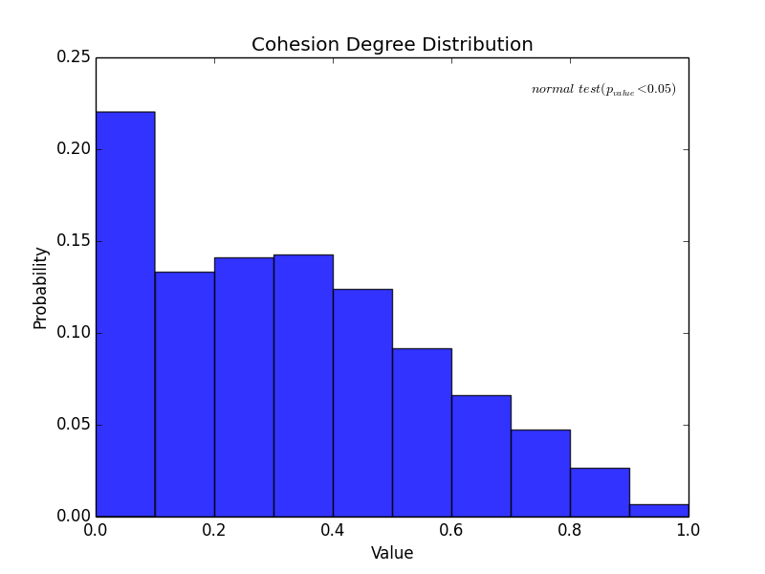
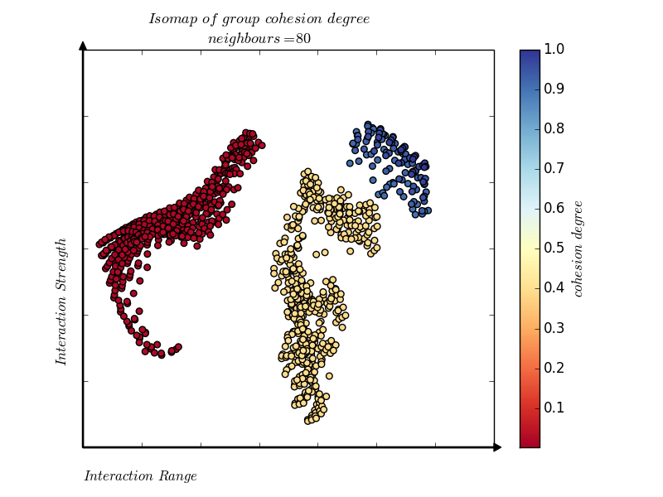
Last week – Problems in group cohesion degree
1 Incorrect sampling method
500 highest data points in the range [0.9,1.0]. There is only 117 data points in this range.
2.Correlation coefficient is not high
Pearson correlation testing:
(x-axis: Interaction Range, r = 0.86 , p-value = 0.0)
(y-axis: Interaction Strength, r = 0.72, p-value = 0.0)
Spearman correlation testing:
(x-axis: Interaction Range, r = 0.80 , p-value = 0.0)
(y-axis: Interaction Strength, r = 0.76, p-value = 0.0)
3. Standard Deviations of parameters in ranges were not sufficient to represents the parameter’s consistence in clusters
The 117 data points in the range [0.9,1.0] have the same value of Interaction Range at 2.0
Notes:
Not sufficient data points in 117
After centered and calculated standard deviation, the Spearman correlation does not assume that both datasets are normally distributed
Parameter
Range [min-max]
Step to vary
V [1.0-3.0] , 0.2
t(s) [0.2-2.0], 0.2
A, [1.0-4.0], 0.2
B, [0.2-2.0], 0.2

Slide 3
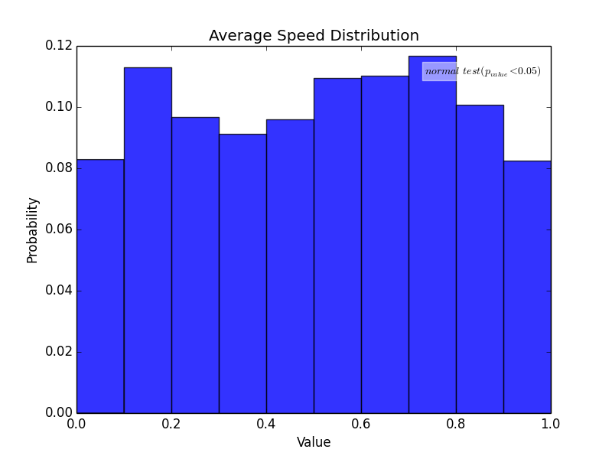
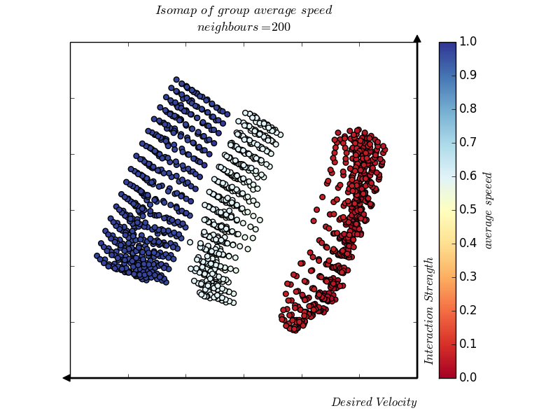
Last week –Group average speed
Correlation coefficient between ISOMAP axes and parameters
Pearson correlation testing:
(x axis-:Desired Velocity, r = -0.954, p-value = 0.0)
(y-axis: Interaction Strength, r = 0.902, p-value = 0.0)
Spearman correlation testing
(x-axis: Interaction Range, r = -0.932 , p-value = 0.0)
(y-axis: Interaction Strength, r = 0.906, p-value = 0.0)
Notes:
The Spearman correlation coefficient is the non-parametric equivalent of the Pearson correlation coefficient. It similarly takes values between -1 and +1, the difference is that it quantifies the extent to which the variables tend to increase or decrease together ie. However a Spearman correlation of + or -1 can occur where the Pearson correlation is nearer to zero.

Slide 4
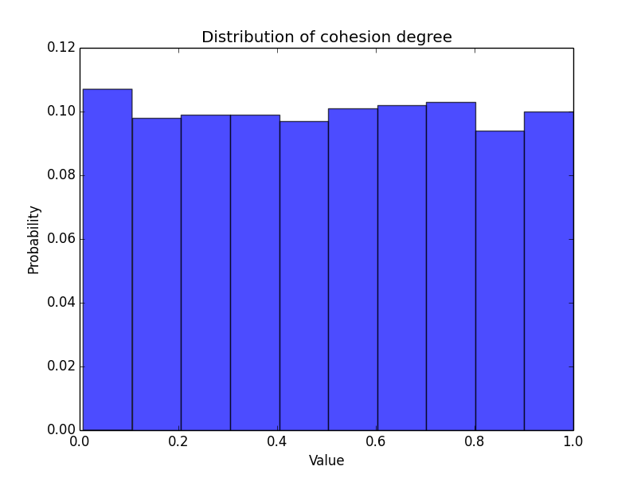
2. Uniform sampling method. Group cohesion degree
Randomly select the same number of samples in different bins
Total 1000 samples
Notes:
Histogram of parameters
Repeat for other times but don’t show here

Slide 5
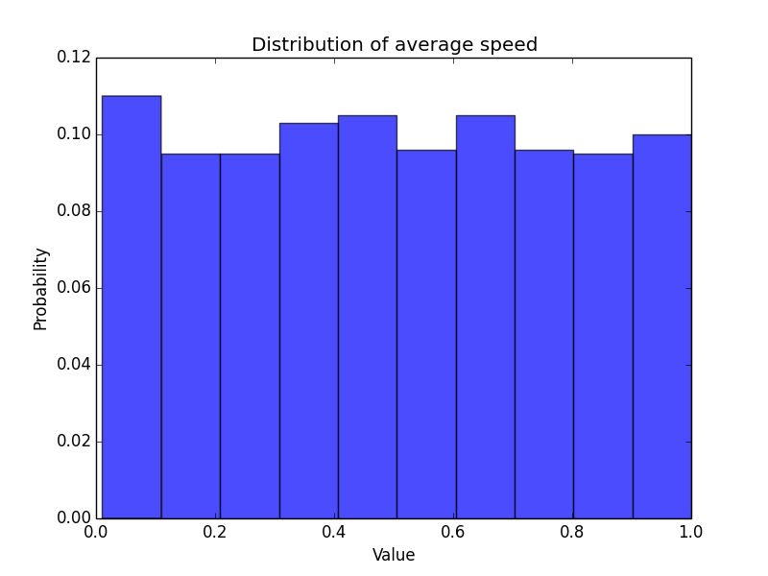
2. Uniform sampling method. Group average speed
Randomly select the same number of samples in different bins
Total 1000 samples
Notes:
After normalized

Slide 6
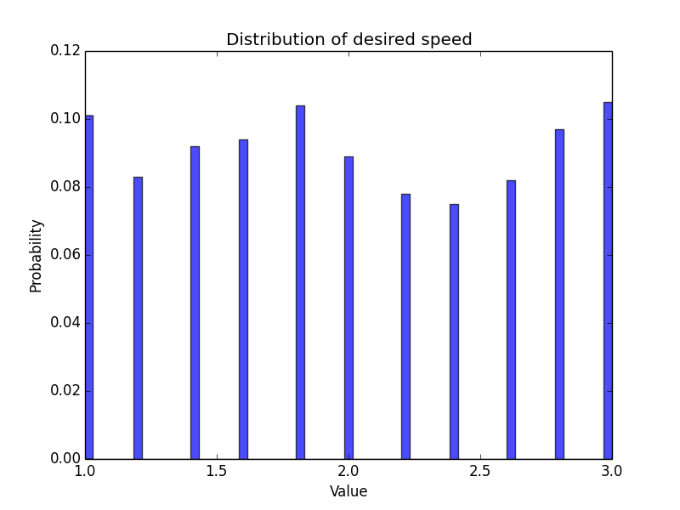
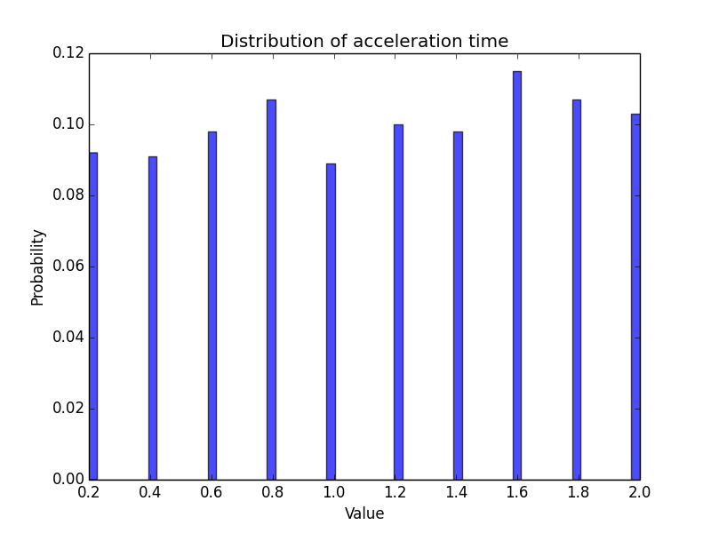
2. Uniform sampling method. Group cohesion degree
Parameter distributions of these samples
Notes:
Histogram of parameters
Repeat for other times but don’t show here

Slide 7
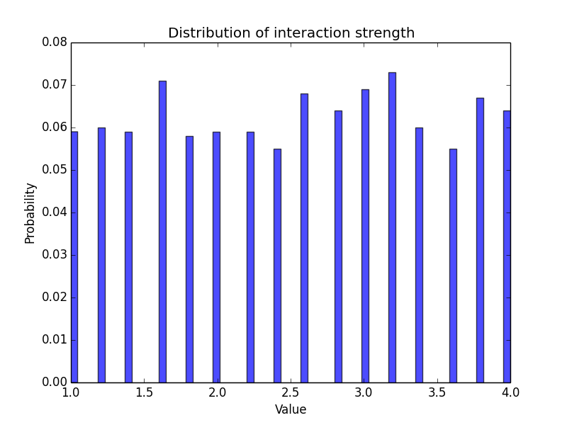
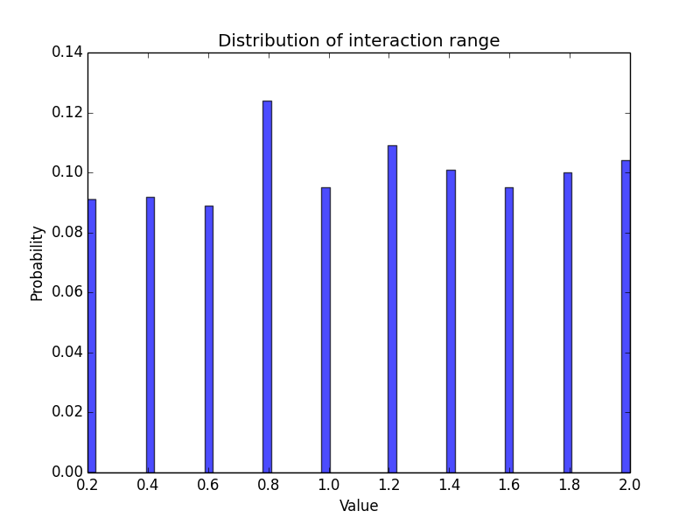
2. Uniform sampling method. Group cohesion degree
Parameter distributions of these samples
Notes:
Histogram of parameters
Repeat for other times but don’t show here

Slide 8
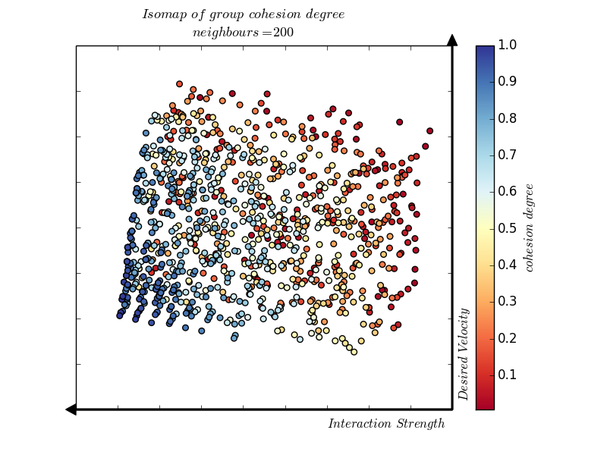
3. Group cohesion degree analysis. ISOMAP
Spearman correlation testing:
(x-axis: Interaction Range, r = -0.979 , p-value = 0.0)
(y-axis: Interaction Strength, r = 0.936, p-value = 0.0)

Slide 9
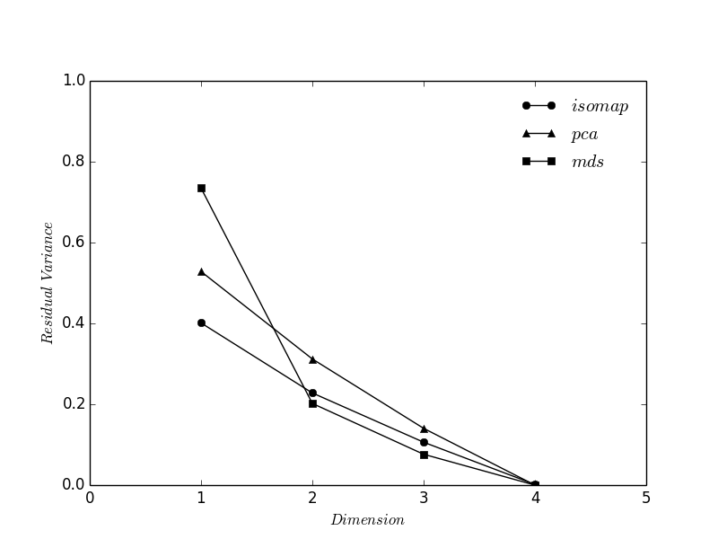
3. Group cohesion degree analysis
Notes:
K is important

Slide 10
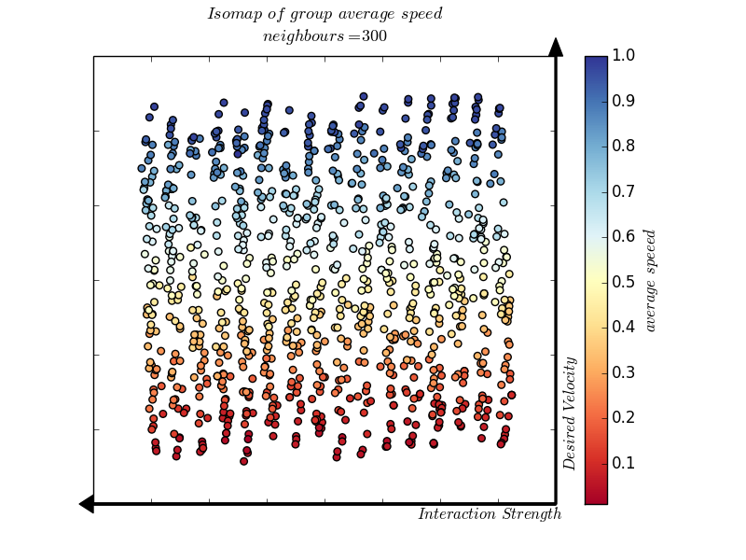
3. Group average speed analysis. ISOMAP
Spearman correlation testing:
(x-axis: Interaction Strength, r = -0.998 , p-value = 0.0)
(y-axis: Desired Velocity, r = 0.983, p-value = 0.0)

Slide 11
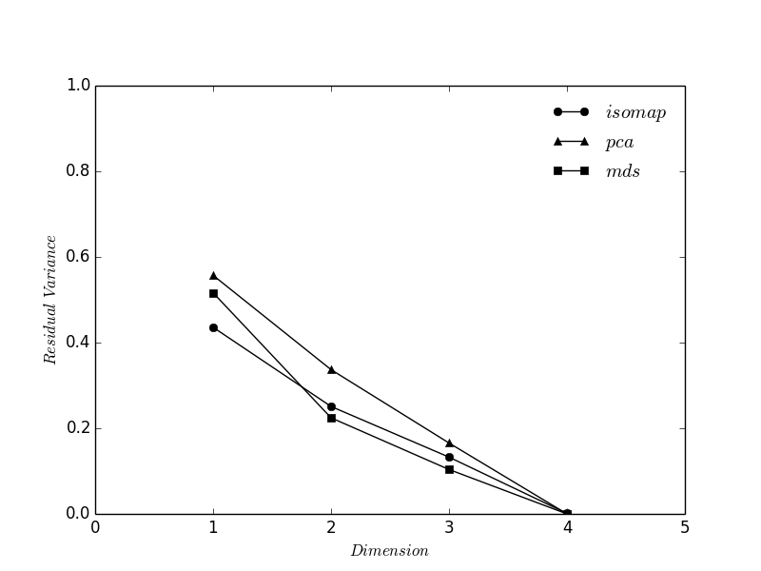
3. Group average speed analysis

Slide 12
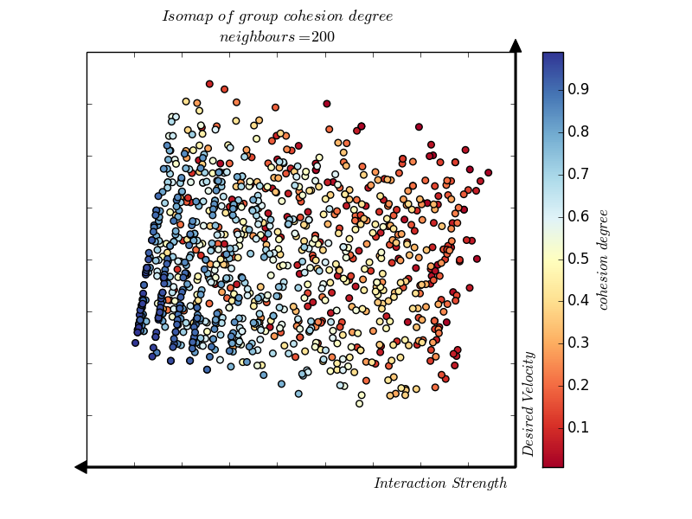
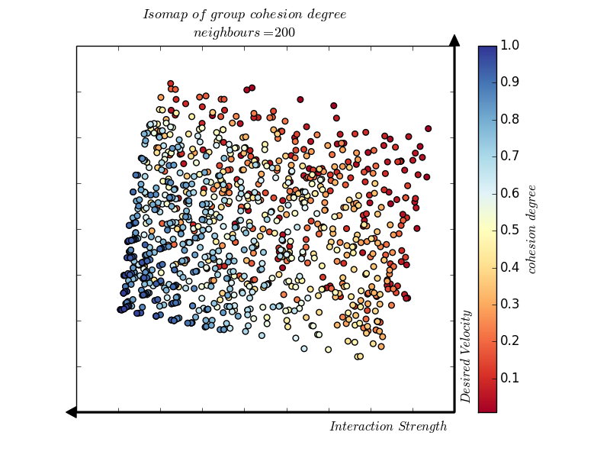
Other sampling times of group cohesion degree
Spearman correlation testing:
(x-axis: Interaction Strength, r = -0.980 , p-value = 0.0)
(y-axis: Desired Velocity, r = 0.929, p-value = 0.0)
Spearman correlation testing:
(x-axis: Interaction Strength, r = -0.983 , p-value = 0.0)
(y-axis: Desired Velocity, r = 0.929, p-value = 0.0)

Slide 13
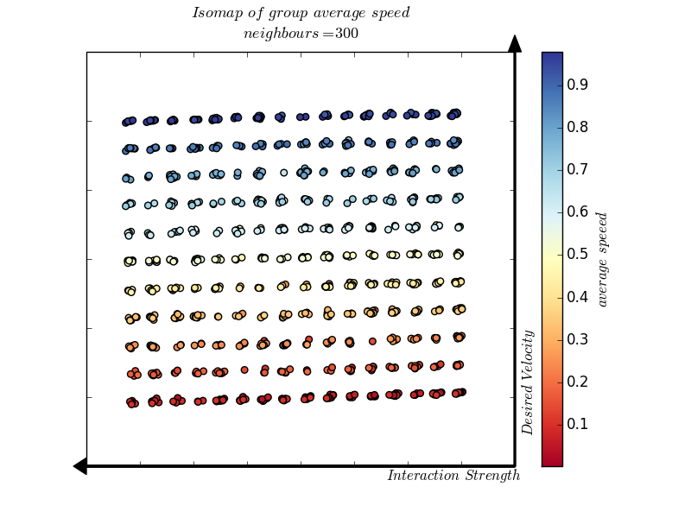
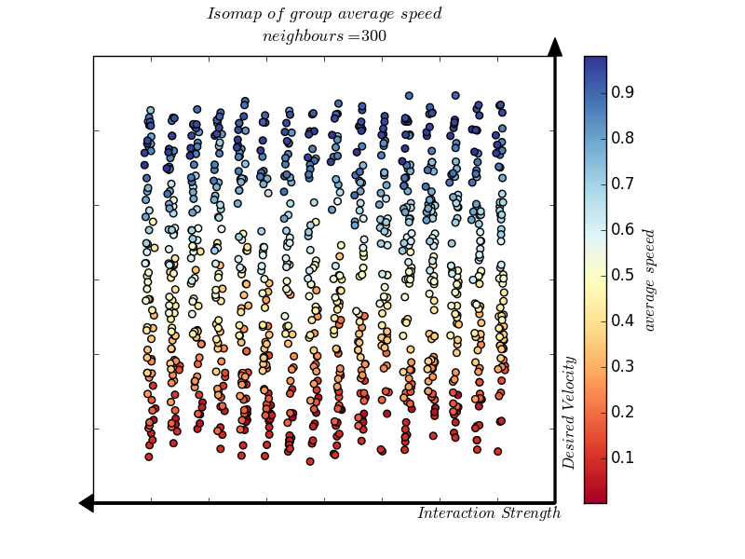
Other sampling times of group average speed
Spearman correlation testing:
(x-axis: Interaction Strength, r = -0.998 , p-value = 0.0)
(y-axis: Desired Velocity, r = 0.996, p-value = 0.0)
Spearman correlation testing:
(x-axis: Interaction Strength, r = -0.998 , p-value = 0.0)
(y-axis: Desired Velocity, r = 0.987, p-value = 0.0)

Slide 14
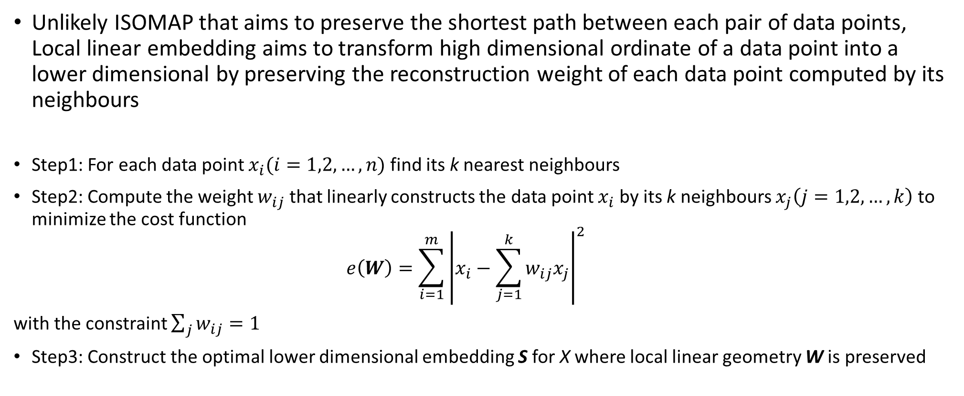
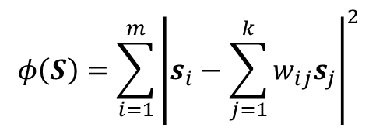
Local Linear Embedding algorithm (LLE)
Unlikely ISOMAP that aims to preserve the shortest path between each pair of data points, Local linear embedding aims to transform high dimensional ordinate of a data point into a lower dimensional by preserving the reconstruction weight of each data point computed by its neighbours
Step1: For each data point $x_{i}(i=1,2,…,n)$ find its k nearest neighbours
Step2: Compute the weight $w_{ij}$ that linearly constructs the data point $x_{i}$ by its k neighbours $x_{j}\left(j=1,2,…,k\right)$ to minimize the cost function
$$e\left(W\right)=\sum_{i=1}^{m}{{\left|x_{i}−\sum_{j=1}^{k}{w_{ij}x_{j}}\right|}^{2}}$$
with the constraint $\sum_{j}{w_{ij}=1}$
Step3: Construct the optimal lower dimensional embedding S for X where local linear geometry W is preserved
$$φ\left(S\right)=\sum_{i=1}^{m}{{\left|s_{i}−\sum_{j=1}^{k}{w_{ij}s_{j}}\right|}^{2}}$$
Notes:
Similar with ISOMAP, same year published,
Find nearest neighbors of each datapoint based on Euclidian distance
Construct the property that need to be preservered
Embedd to lower dimensional by optimizing

Slide 15
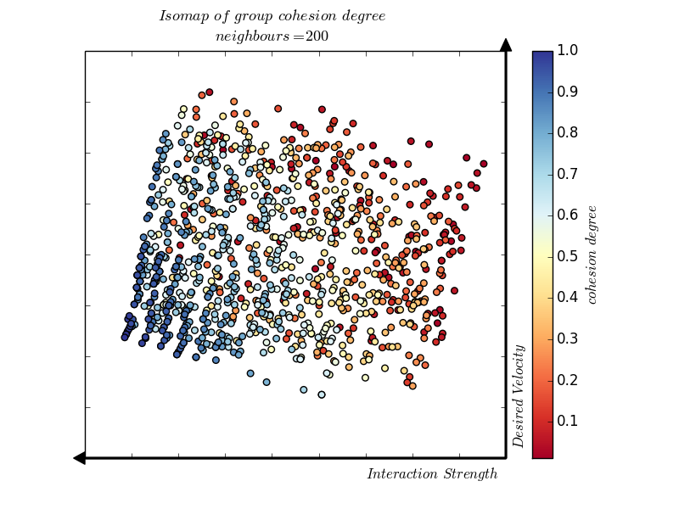
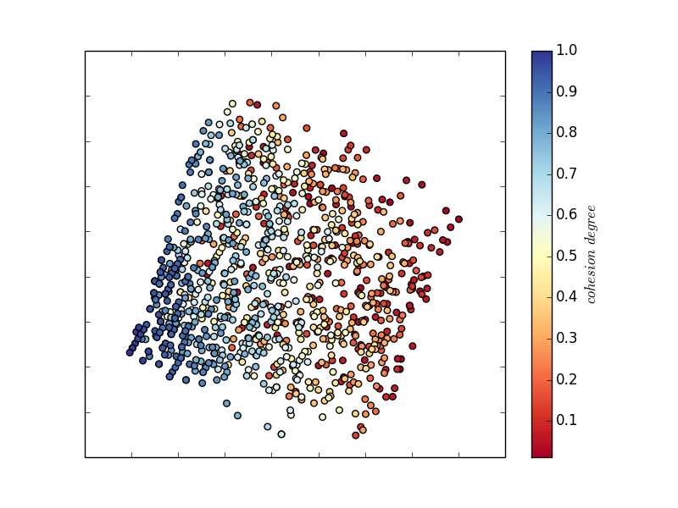
3. Group cohesion degree analysis.
Error rate = 0.25
Error rate = 0
ISOMAP
LLE
Spearman correlation testing:
(x-axis: Interaction Strength, r = -0.972 , p-value = 0.0)
(y-axis: Desired Velocity, r = 0.913, p-value = 0.0)
Spearman correlation testing:
(x-axis: Interaction Strength, r = -0.915 , p-value = 0.0)
(y-axis: Desired Velocity, r = 0.849, p-value = 0.0)
Notes:
Unlikely ISOMAP that preserve the shortest path between each pair of datapoints, Local linear embedding aims to transform high dimensional ordinate of a data point into a lower dimensional by using the weight transformation of that datapoint computed in a high dimensional, preserve the reconstruction weight of each datapoint by its neighbors.
In addition to learning the local structure of the manifold, this technique promotes ro-bustness, since an outlier only affects its neighbors.
For each point, LLE finds coefficients for its neighbors that best describe it using a
linear combination which generates the lowest reconstruc-
tion error. After these sets of coefficients are computed, LLE
computes a mapping to a low-dimensional space where each
point can be approximated with these coefficients while min-
imizing reconstruction error.

Slide 16
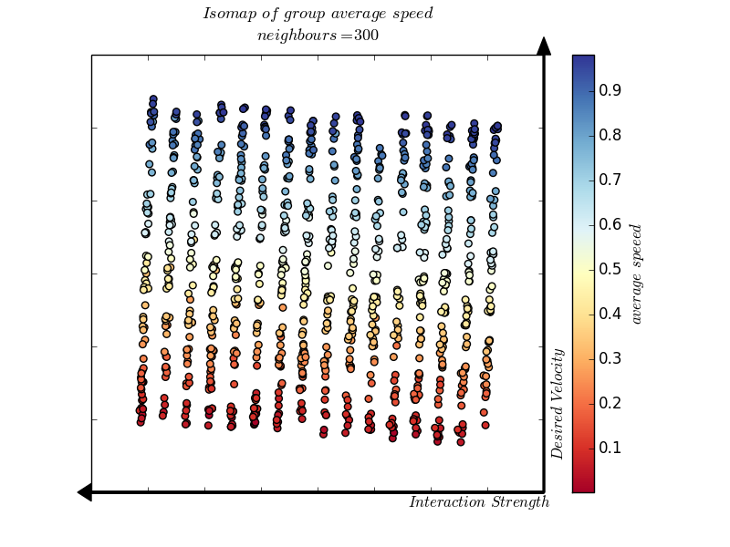
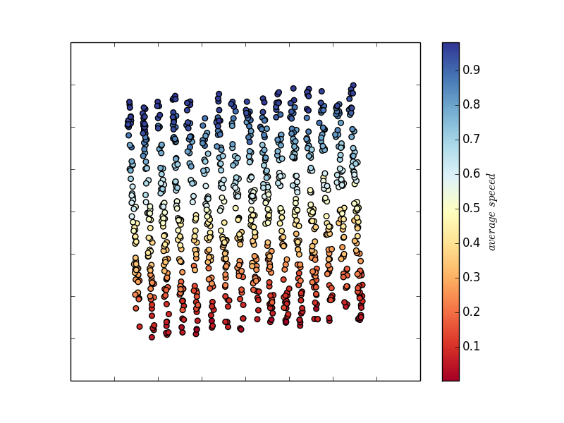
3. Group average speed analysis
ISOMAP
LLE
Spearman correlation testing:
(x-axis: Interaction Strength, r = -0.998 , p-value = 0.0)
(y-axis: Desired Velocity, r = 0.994, p-value = 0.0)
Spearman correlation testing:
(x-axis: Interaction Strength, r = 0.988 , p-value = 0.0)
(y-axis: Desired Velocity, r = 0.985, p-value = 0.0)
Notes:
Unlikely ISOMAP that preserve aims to preserver the shortest path between each pair of data points, Local linear embedding aims to transform high dimensional ordinate of a data point into a lower dimensional by preserve the reconstruction weight of each data point by its neighbors.
In addition to learning the local structure of the manifold, this technique promotes ro-bustness, since an outlier only affects its neighbors.
For each point, LLE finds coefficients for its neighbors that best describe it using a
linear combination which generates the lowest reconstruc-
tion error. After these sets of coefficients are computed, LLE
computes a mapping to a low-dimensional space where each
point can be approximated with these coefficients while min-
imizing reconstruction error.

Slide 17
Sensitivity Analysis-Sobol Method
Unlike local analysis (which vary parameter at one time)

Slide 18
5. Discussion
Group cohesion degree depends on Interaction Strength
Group average speed depends on Desired Velocity
Concerns about experimental design:
Is the grid combination of parameter values correct?
How to make sure the monitoring period in simulation is correct?
Verify the effect of parameter through simulation design

Slide 19
5. Discussion
Why do we need to understand the parameter contribute most to the variance of model’s output?
Design experimentally to test then extract data for panic
Refine our estimate to extract those parameter in real-time to increase predictive capacity rather than collect whole parameter in real-time
Vary parameters to simulate the interaction of groups, this work is to help for effective evacuation plan

